Slide 1
MIS 64060 Final Exam Presentation Fuel receipts costs - PUDL
Pranay Kumar Kodeboyina
811251177
pkodeboy@kent.edu

Slide 2
Objective and Problem Statement
In order to examine the monthly fuel contract data, purchases, and prices associated with US energy statistics.
Data includes details regarding the energy industry in the United States.
20 variables and 608,565 rows in the data set give information.
Data gives information on a variety of fuel-related topics such as cost, sulphur and ash content, heat produced per unit resource, suppliers, and many more.
Public Utility Data Preparation (PUDL) - Power generation in the US

Slide 3
Data Variables Included and Excluded
contract_type_code
energy_source_code
fuel_group_code
fuel_received_units
fuel_mmbtu_per_unit
sulfur_content_pct
ash_content_pct
fuel_cost_per_mmbtu
primary_transportation_mode_code
fuel_type_gas
fuel_type_coal
fuel_type_oil
In order to examine the monthly fuel contract data, purchases, and prices associated with US energy statistics. We have considered the Numeric variables
Missing values: Excluded variables having more than 50% missing values.
Variable | Percentage_Missing
mine_id_pudl | 64.40506
mercury_content_ppm | 47.56805
moisture_content_pct | 84.88639
chlorine_content_ppm | 84.88639

Slide 4
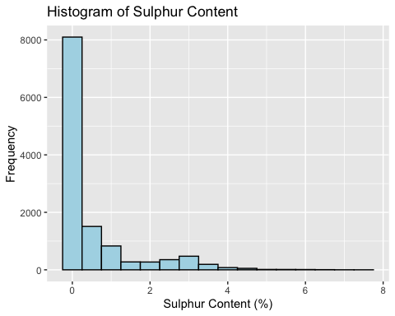
Data Exploration – Sulphur Content
According to the dataset, the average sulphur content for each fuel type is as follows:
Gas: 0.001%
Oil: 0.265%
Coal: 0.421%
It is important to consider the potential environmental impact of burning fuels with high sulphur content, such as the emission of sulphur dioxide, which can contribute to acid rain and other negative effects on air quality and public health.

Slide 5
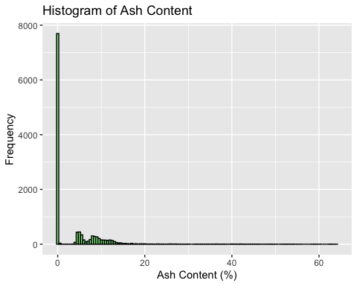
Ash Content and Fuel Distribution : PUDL
Gas is a fuel that does not contain any ash content since it is a gaseous fuel.
Oil has a very low ash content, typically less than 1%, because it is a liquid fuel and is more refined than coal.
Coal has a much higher ash content than gas and oil, typically ranging from 5% to 40% depending on the type of coal. This is because coal is a solid fuel and contains more impurities than gas and oil.

Slide 6
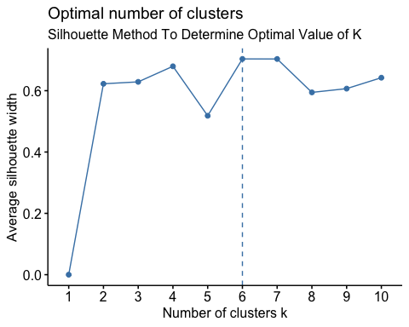
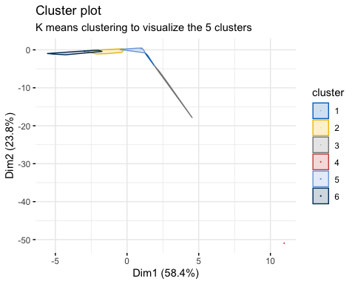
K – Means (Elbow and Silhouette) - Overlap

Slide 7
Clustering Technique- DBSCAN
As K mean technique resulted in overlapping clusters – using DBSCAN.
DBSCAN can identify arbitrarily shaped clusters in the data.
DBSCAN can handle noise and outliers effectively, by assigning them to a separate cluster or labelling them as noise.
It is a fast and scalable algorithm that can be applied to large datasets with high dimensionality.

Slide 8
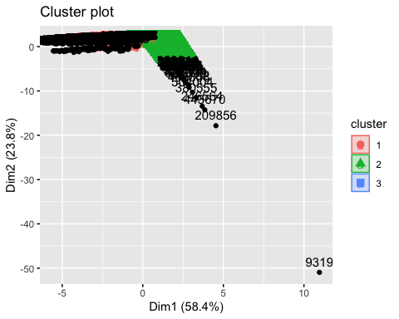
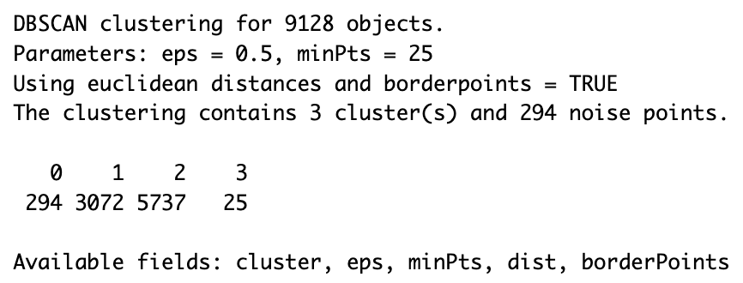
DBSCAN method Clustering of Sample data
DBSCAN algorithm is used to form clusters in order to draw meaningful insights about U.S. energy.
DBSCAN is known to be the best algorithm that handles outliers and noisy data.

Slide 9
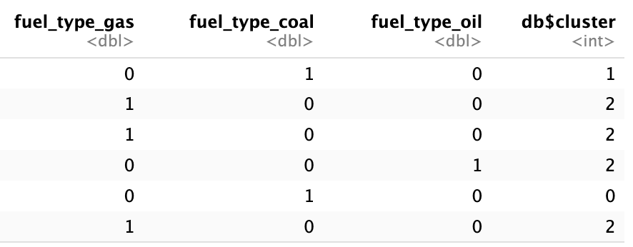
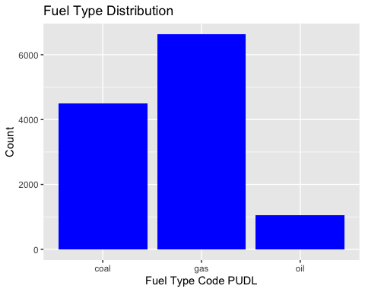
Data Findings - Cluster information
Cluster 1 - Gas
Cluster 2 - Oil
Cluster 3 - Coal
Name | cluster | avg_units | avg_cost | avg_mmbtu
Gas | 1 | 45303.13 | 2.691056 | 21.660984
Oil | 2 | 333651.24 | 7.235618 | 1.672761
Coal | 3 | 7182.6 | 3.23268 | 12.45712

Slide 10
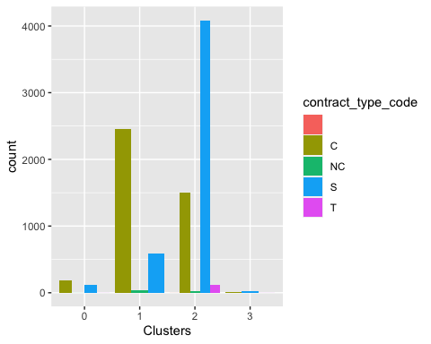
Analysis of Clusters 1: Gas
Low Fuel cost per MMBtu
The highest Number of units received
No chemical components
Heat generated is less
Contract type is Contract based.

Slide 11
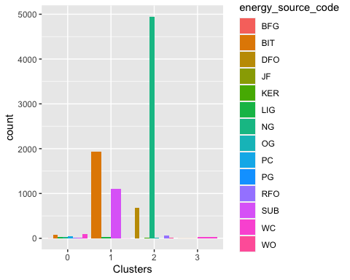
Analysis of Clusters 2: Oil
Highest Fuel cost per MMBtu
Least number of units received
Small percent of Sulfur Content
The heat generated is 1.6 MMBtu
Contract type is Spot

Slide 12
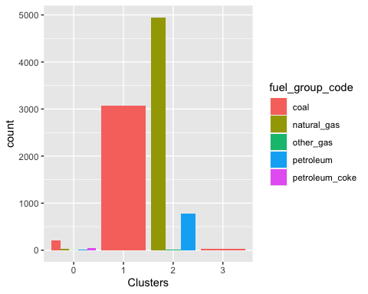
Analysis of Clusters 3: Coal
Lowest Fuel cost per MMBtu
High fuel units received
Contains Fuel, ash, sulfur content
Heat generated is High
Contract type is Contract and Spot

Slide 13
Conclusion
If the goal is to produce more heat at low cost, we need to choose the efficient cluster.
If the goal is to produce heat without causing any harm to nature then we need to choose the sustainable cluster

